Slide 1
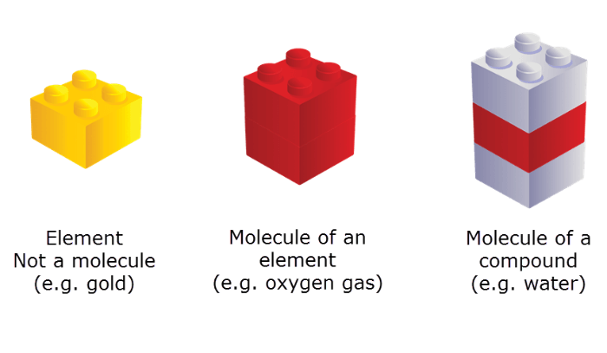
Atoms, Compounds and Mixtures:
An atom is the most basic building block of matter. Everything is made up of atoms!
An element is a substance containing only one type of atom. For example, elemental copper contains only copper atoms.
A compound is a substance containing at least two different types of atom. Compounds can be molecules (such as H2​O) or lattices (such as Al2​O3​).

Slide 2
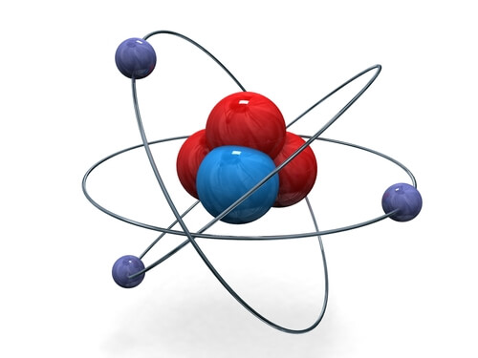
Atoms are made up of three subatomic particles: protons, neutrons and electrons.
The nucleus (centre) of an atom is made up of protons and neutrons. The electrons orbit around the outside in shells.

Slide 3
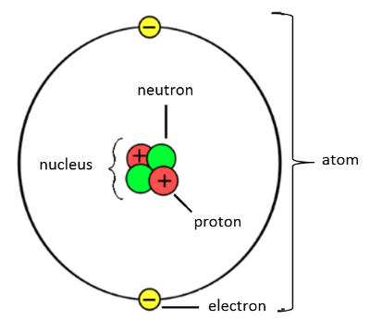
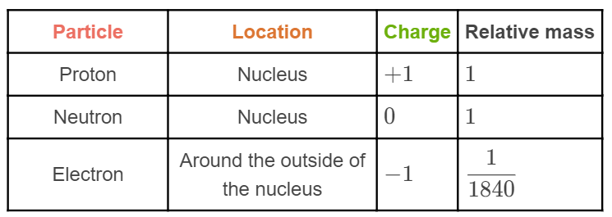
Atoms are made up of subatomic particles.
This table summarises the information you should know about the different subatomic particles:

Slide 4
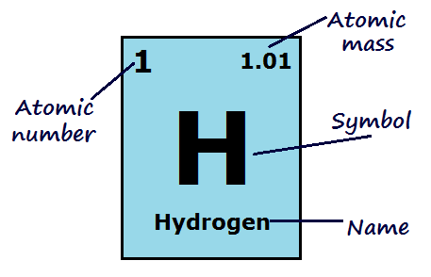
Atomic Number and Mass Number
The atomic number is the number of protons in an atom. It is equal to the number of electrons in the neutral atom.
The mass number is the number of protons plus neutrons in an atom.
The atomic mass is the average mass number of an element (the average number of protons plus neutrons).

Slide 5
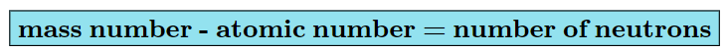
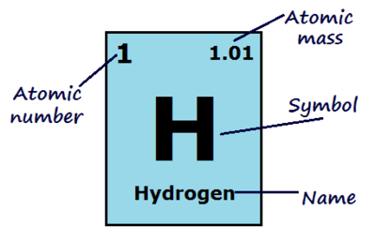
Calculating the number of neutrons
To find the number of neutrons in an atom, subtract the atomic number from the mass number.

Slide 6
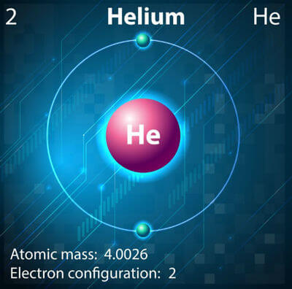
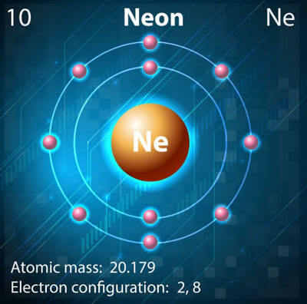
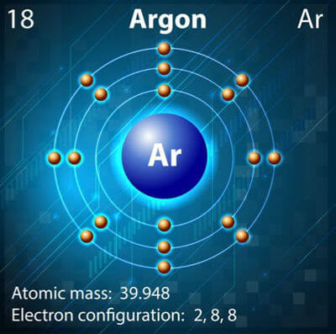
The first electron shell can hold two electrons.
The second electron shell can hold eight electrons.
The third electron shell can hold eight electrons.
Electrons will always fill up the lowest electron shells first.

Slide 7
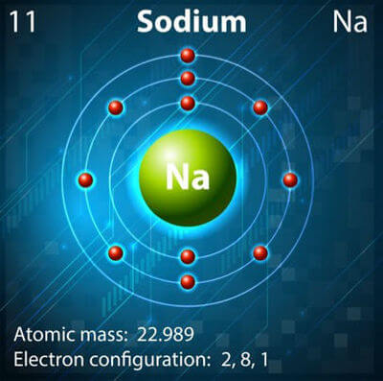
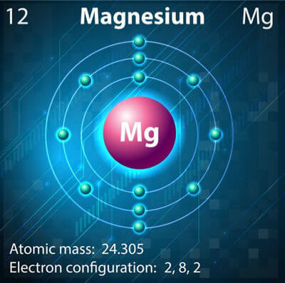
Valence electrons are the electrons in the outermost shell.
These are the only electrons which are involved in bonding.
For example, sodium has one valence electron, while magnesium has two.

Slide 8
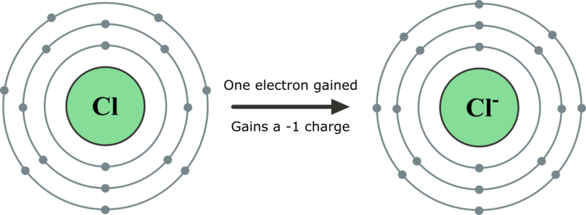
Summary: How Ions Form
If an atom does not have a full valence shell, it will gain or lose electrons in order to fill the outer shell and become more stable.
When an atom gains or loses electrons, it becomes electrically charged. A charged atom is called an ion.

Slide 9
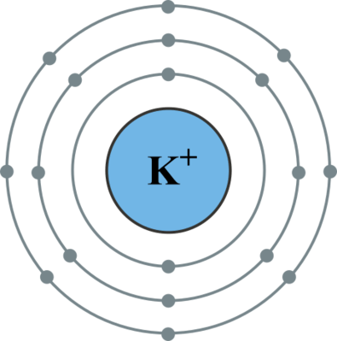
Summary: Cation Formation
If an atom has very few electrons in its outer shell, it will lose electrons to empty the outer shell, leaving only full electron shells. The ion that is formed will have a positive charge equal to the number of electrons lost. A positive ion is called a cation.
For example, a potassium atom has 1 electron in its valence shell, so it loses this electron to achieve a full valence shell. The potassium ion that forms has one less electron than the number of protons in its nucleus, so it has a charge of +1.

Slide 10
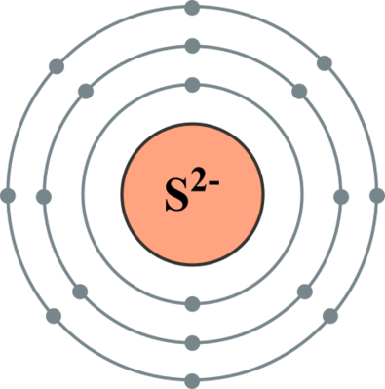
Summary: Anion Formation
If an atom has many electrons in its valence shell, it will gain electrons to fill the outer shell. The ion that is formed will have a negative charge equal to the number of electrons gained. A negative ion is called an anion.
For example, a sulfur atom has 6 electrons in its valence shell, so it gains two electrons to achieve a full valence shell. The sulfide ion that forms has two more electrons than the number of protons in its nucleus, so it has a charge of -2.

Slide 11
Summary: Naming Ions
Cations (metal ions, plus hydrogen) have the same name as their parent atom. For example:
lithium atom→lithium ion
Anions (non-metal ions) have a different name to their parent atom. The end of their names is replaced with -ide. For example:
oxygen atom→oxide​ ion
For atoms that can form more than one ion, like iron, the Roman numerals I, II or III are used to show the charge on the ion. For example, Fe2+ is called the iron(II) ion, and Fe3+ is called the iron(III) ion.

Slide 12
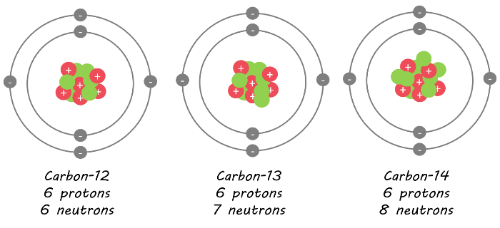
Isotopes are atoms of the same element that have different numbers of neutrons but the same number of protons and electrons.
This means that they have different mass numbers but the same atomic number.

Slide 13
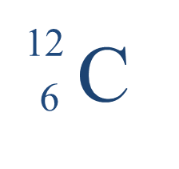
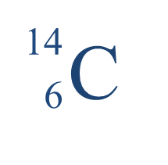
Isotopes are named based on their mass number.
The element's name is written first, followed by the mass number.
For example, these are two carbon isotopes. The first one has a mass number of 12, so is called carbon-12. The second one has a mass number of 14, so is called carbon-14.

Slide 14
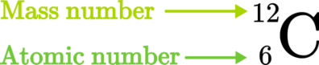
The atomic symbol of an isotope shows the chemical symbol of the element, with the mass number and atomic number written to the left.
For example, carbon-12 is written like this:
The mass number is the larger number (number of protons plus neutrons) and this is written at the top. The atomic number is the smaller number (number of protons) and this is written at the bottom.

Slide 15
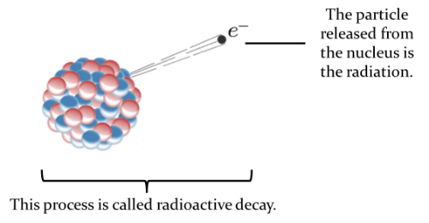
Radioactive decay is the process of radioactive atoms breaking down into other types of atoms.
During this process, the atoms release radiation. Radiation is the energy or particles released from the radioactive atom's nucleus.

Slide 16
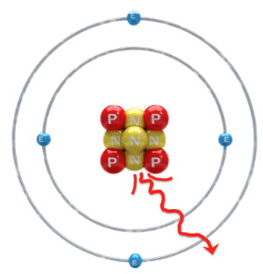
The stability of an atom is determined by the ratio of protons to neutrons in its nucleus.
If there are too many protons or too many neutrons, the atom will be unstable and will undergo radioactive decay in order to become stable again.

Slide 17
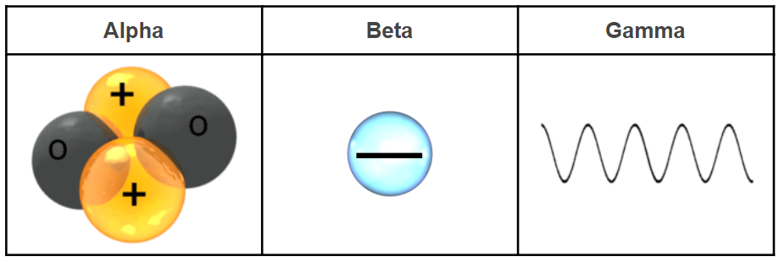
There are three main types of radiation: alpha, beta and gamma.
Each type of radiation releases a different type of particle or wave.
Alpha particles are made up of two protons and two neutrons. They are the same as a helium nucleus. This means they have a charge of +2.
Beta particles are made up of one electron. This means they have a charge of −1.
Gamma rays are electromagnetic waves. They have no mass and no charge.

Slide 18
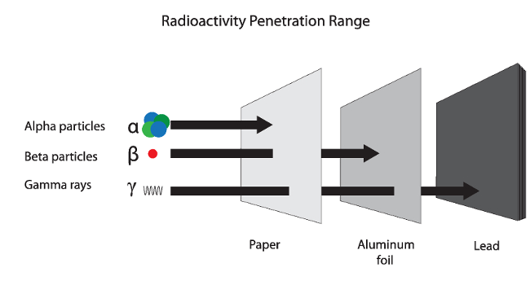
The different types of radiation have different penetrating abilities.
This means they can move different distances through materials. The penetrating ability depends mainly on speed.
Alpha particles are large and move slowly (about 5% the speed of light). This means they have a low penetrating ability and can be stopped by a few centimetres of air or a piece of paper.

Slide 19
Beta particles are smaller and move much faster than alpha particles.
They move at about 90% the speed of light. This means they have a moderate penetrating ability and can be stopped by a few metres of air or a thin sheet of aluminium.

Slide 20
Gamma rays are electromagnetic waves so they move very fast (at the speed of light).
This means they have a high penetrating ability. They cannot be fully stopped, but they can be reduced by a thick slab of lead or concrete.

Slide 21

The Law of Conservation of Mass states that mass is never lost or gained during a chemical reaction or a physical change.
This means that more mass cannot be produced in a reaction or by a physical change, and mass cannot be destroyed during a reaction or physical change.

Slide 22
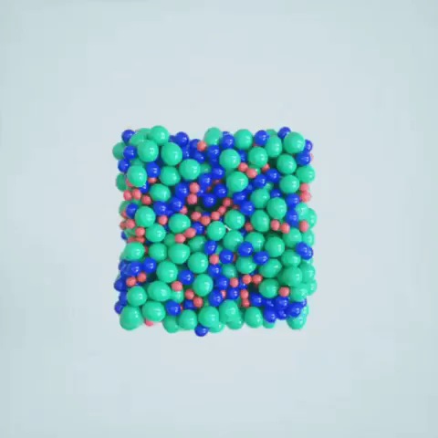
Mass is determined by how many atoms are in an object.
In a chemical reaction or physical change, the mass of the starting substances (reactants) must be equal to the mass of the finishing substances (products).
This means we have the same number of atoms.
They are arranged differently now, because of the process, but no atoms have disappeared, appeared or changed to a different element.

Slide 23

Exothermic reactions and processes happen when a reaction loses energy.
The products have less energy than the reactants, meaning that energy is released during the reaction.
Generally these reactions feel hot, but not always: fires and explosions are exothermic, but so is the process of freezing, since heat is removed from the liquid as it becomes solid.

Slide 24
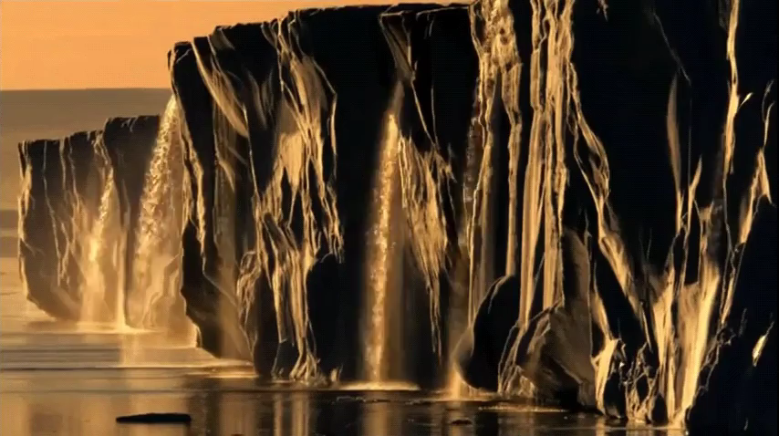
Endothermic reactions and processes happen when a reaction gains energy.
The products have more energy than the reactants, meaning that energy is absorbed during the reaction.
Generally these reactions feel cold, but not always: an ice pack feeling cold is endothermic, but so is the process of melting, since heat is absorbed by the solid as it becomes liquid.

Slide 25

All acids have similar chemical properties.
Most commonly, acids react easily with chemicals such as bases and metals.
They are also corrosive, sour-tasting and conduct electricity.

Slide 26

All bases have similar chemical properties.
Most commonly, bases react with acids.
Bases are usually also caustic (when very concentrated), taste bitter and conduct electricity. A lot of basic cleaners in particular will also feel slippery (for example, soap).

Slide 27
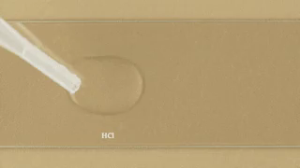
Neutralisation reactions happen when a base is added to an acid.
Here are the different reactions which happen with three specific types of base:
acid + hydroxide → salt + water
acid + oxide → salt + water
acid + carbonate → salt + water + carbon dioxide
Thermal imaging of the reaction the neutralisation reaction between hydrochloric acid (HCl) and sodium hydroxide (NaOH).

